Slide 1
Marine Pollution
The introduction by man, directly, or indirectly, of substances or energy to the marine environment resulting in deleterious effects such as: hazards to human health, hindrance to marine activities, impairment of the quality of seawater for various uses and reduction of amenities

Slide 2
Types of Marine Pollution
• Sedimentation
• Agricultural runoff (herbicides, pesticides and nutrients)
• Energy (thermal and light)
• Sewage (Faecal form and nutrients)
• Solid Waste
• Chemicals, Metals and Radioactive
Substances
• Oil
• Biological

Slide 3
Sources of Pollution
Oil Pollution
Heavy Metals
DDT - Bioaccumulation
Radioactive Waste Disposal
Disposal of Sewage
Harmful Algal Blooms

Slide 4
Major Marine Pollutants – Metals
• Introduced dangerous metals include mercury, lead, and copper
• Heavy Metals are a great concern because they enter the food chain
• Fuel combustion, electric utilities, steel and iron manufacturing,
fuel oils, fuel additives and incineration of urban refuse are the major
sources of oceanic and atmospheric contamination by heavy metals
• Copper is dangerous to marine organisms and has been used in
marine anti-fouling paints
• Mercury and lead poisoning cause brain damage and behavioral
disturbances in children
• Contaminated land runoff, rain of pollutants from the air, and fallout
from shipwrecks pollute the ocean with dangerous metals

Slide 6
Sources of Pollution
From Land
• 80% of non-biological marine pollution
comes from land based activities
• Most obvious inputs via pipes discharging directly into
marine waters (sewage, industrial, chemical and food
processing wastes)
• River flows into the sea carry pollutants from the entire
catchments area.
From Air
• Global atmospheric inputs to the sea from air discharges

Slide 7
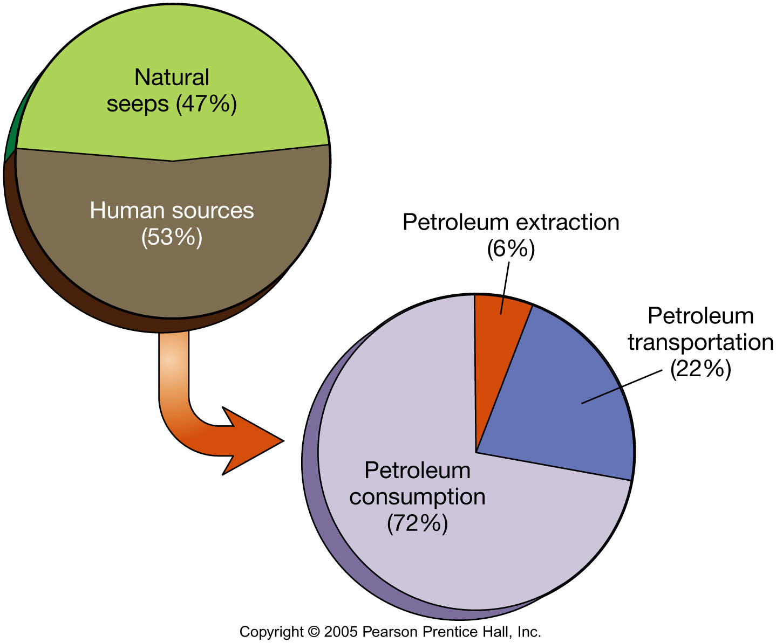

Slide 8
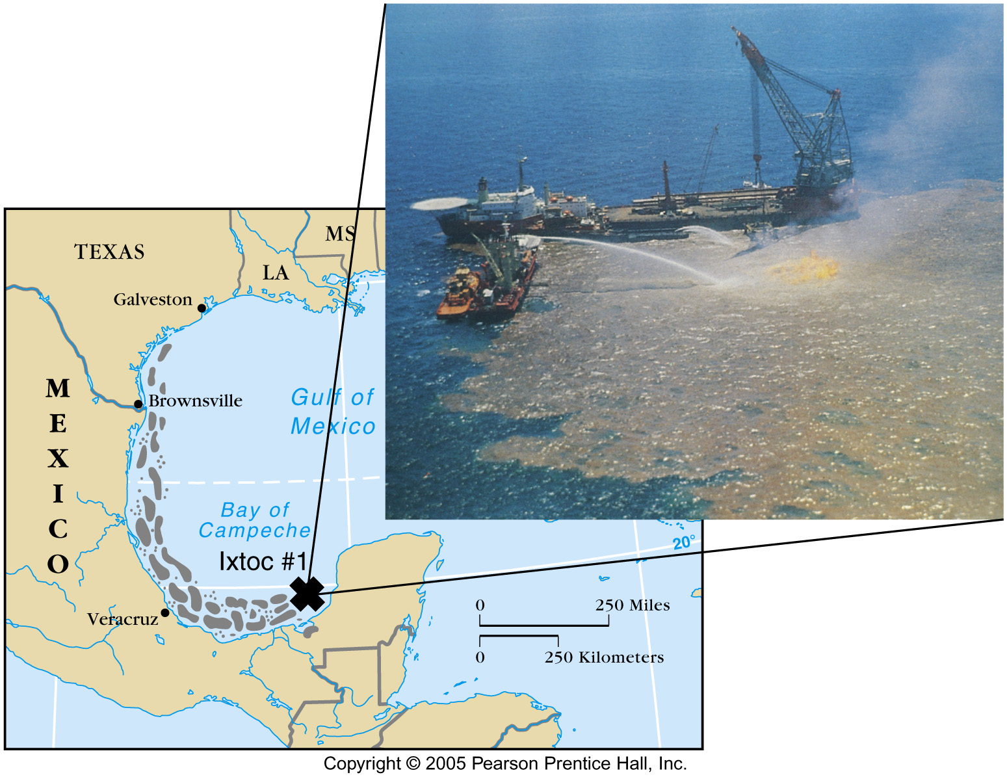

Slide 9
Major Marine Pollutants – Solid Waste
• A large portion and great danger is non biodegradable plastic
• Sea turtles mistake plastic bags for jellyfish and die from internal blockages.
• Seals and sea lions starve after being entangle by nets or muzzled by six-pack rings (decomposition time 400 years).
• Plastic debris kills 100,000 marine mammals and 2 million sea birds die annually

Slide 10
Impacts of Marine Pollution
Generally marine pollution affects ecosystem
health, public health, recreational water quality and
economic viability in the following ways:
• Eutrophication
• Toxicity
• Carcinogenic

Slide 11
Control Of Marine Pollution
LOCAL COMMUNITIES NEAR SEA MUST PROTECT SEA
MANAGEMENT BY GOVERNMENT
INCENTIVES MUST BE OFFERED FOR CONSERVATION
INDUSTRIAL UNITS SHOULD BE EQUIPPED WITH POLLUTION CONTROL INSTRUMENTS
OIL FLOATING ON THE SEA CAN BE REMOVED BY USING
SKIMMERS
ABSORBENTS
COAGULANTS

Slide 12
Protective Measures
MUNICIPAL AND INDUSTRIAL WASTES SHOULD BE
TREATED WELL AND DISPOSED TO SEA
POLLUTION LEVELS SHOULD BE DETECTED
PERIODICALLY
SOIL EROSION IN THE COAST HAS TO BE ARRESTED
RECREATIONAL BEACHES SHOULD BE MAINTAINED
TO MEET HYGIENIC STANDARD

