Slide 1
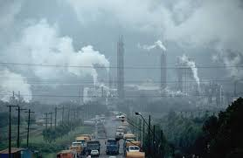
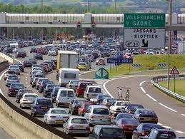
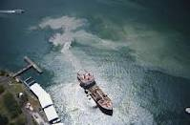
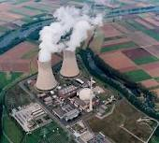
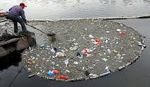
Environmental Pollution
Pollution Control to save
the Earth

Slide 2
Contents
Environmental Pollution: Definition – Causes, pollution effects and control measures of Air, Water, Soil, Marine, Noise, Thermal, Nuclear hazards. Solid waste management: causes, effects and control measures of urban and industrial wastes, pollution measures, case studies, Disaster management: floods, earthquake, cyclone and landslides.

Slide 3
What is Environmental Pollution?
The word pollution comes from the Latin word “pollutionem” meaning to defile or to make dirty.
For normal and healthy living a conducive environment is required by all the living beings, including humans, livestock, plants, micro-organisms and the wildlife. The favourable unpolluted environment has specific composition. When this composition gets changed by addition of harmful substances, the environment is called polluted environment and the substances polluting it are called pollutants.
Environmental pollution can, therefore, be defined as any undesirable change in the physical, chemical or biological characteristics of any component of the environment (air, water, soil), which can cause harmful effects on various forms of life or property.

Slide 4
Types of Environmental Pollution
Air Pollution
Water Pollution
Soil Pollution
Marine Pollution
Noise Pollution
Thermal Pollution
Nuclear Hazards

Slide 5
Types of Pollutants
1) On the basis of decomposition -
A) Non degradable Pollutants
e.g., Aluminium cans, Hg, Pb, Cd , lonf chain phenolic chemicals, DDT.
They pass on from one biological system to another.
B) Bio-degradable Pollutants.
e.g., Domestic sewage
2) On the basis of nature -
A) Physical pollutants: Heat, noise, radioactive pollutants
B) Chemical Pollutants: Oxides of carbon, sulphur, nitrogen, different halogen gases.
C) Biological pollutants: Bacteria, virus, fungi etc.

Slide 6
Types of Pollutants
3) On the basis of state -
A) Solid particulate pollutant
B) Liquid particulate pollutant: Leaked oil slicks oil sea water, dissolved solids, oils and grease
C) Gaseous particulate pollutant: CFCs, SOx, NOx etc.
4) On the basis of their existence in nature -
A) Quantitative pollutant: These are the substances which occur in the environment but becomes pollutant when their concentration reaches beyond a threshold value in the environment. Example: CO₂, NO₂ etc
B) Qualitative pollutant: These are the substances which do not occur in the environment but are passed into it through human activity. Example: fungicides, herbicides, DDT etc

Slide 7
Types of Pollutants
5) On the basis of their of source of origin -
A) Point source pollutant: When the origin source is point e.g., emissions from stack.
B) Line source pollutant: transportation of material by conveyor belts, road rollers, run off seepage etc.
C) Area source pollutant: When the source is an area e.g., blasting in mines

Slide 8
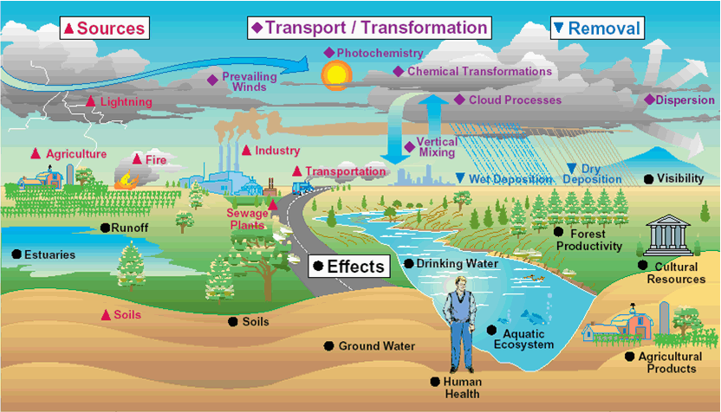
Air Pollution
It is an atmospheric condition in which certain substances (including the normal constituents in excess) are present in concentrations which can cause undesirable effects on man and his environment. These substances include gases, particulate matter, radioactive substances etc. Gaseous pollutants include oxides of sulphur (mostly SO2,SO3) oxides of nitrogen mostly (NO and NO2 or NOx) carbon monoxide (CO), volatile organic compounds (mostly hydrocarbons) etc. “Particulate pollutants include smoke, dust, soot, fumes, aerosols, liquid droplets, pollen grains etc. Radioactive pollutants include Radon-222, iodine-131,strontium-90, plutonium-239 etc.

Slide 9
Classification of Air Pollutants
1) On the basis of decomposition -
A) Non degradable Pollutants
e.g. Aluminium cans, Hg, Pb, Cd , long chain phenolic chemicals, DDT.
They pass on from one biological system to another.
B) Bio-degradable Pollutants e.g. Domestic sewage.
2) On the basis of chemical composition -
Organic pollutants e.g. Hydrocarbons, aldehydes, ketones, amines etc.
B) Inorganic Pollutants e.g. Carbon compounds (CO and carbonates), sulphur compounds (H2S, SO2, H2SO4), nitrogen compounds (NOx, NH3), different halogen compounds (HF, HCl and metallic fluorides)

Slide 10
Classification of Air Pollutants
Inorganic Particles (e.g. Fly ash, silica, asbestos and dusts from transport,
mining, metallurgical and other industrial activities
3) On the basis of state of matter -
A) Gaseous Pollutants
Which get mixed with the air and do not normally settle out, e.g., CO,
NOx and SO2
B) Particulate Pollutants
Which comprise of finely divided soilds or liquids and often exist in
colloidal state as aerosols, e.g., smoke, fumes, dust, mist, fog, smog and
sprays

Slide 11
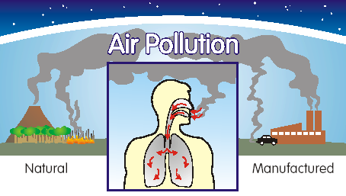
Sources of Air pollution
1) Natural sources
Natural contaminants usually present in the air are pollen, fungal spores, bacteria and marsh gas.
CO from the breakdown of methane
Volcanic eruptions
Forest fire release smoke and harmful trace gases
Salt spray from oceans
Dust storms.
2) Man-made sources
thermal power plants, industrial units,
vehicular emissions,
fossil fuel burning,
agricultural activities

Slide 12
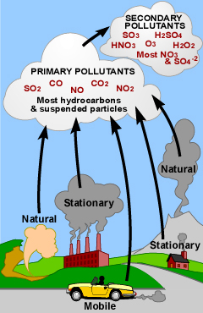
Sources of Air pollution
Thermal power plants have become the major sources
of generating electricity in India as the nuclear power plants
couldn’t be installed as planned. The main pollutants
emitted are fly ash and SO2. Metallurgical plants
also consume coal and produce similar pollutants.
Fertilizer plants, smelters, textile mills, tanneries, refineries,
chemical industries, paper and pulp mills are other sources of air
pollution. Automobile exhaust is another major source of air
pollution. Automobiles release gases such as
carbon monoxide (about 77%), oxides of nitrogen
(about 8%) and hydrocarbons (about 14%).
Heavy duty diesel vehicles spew more NOx and
suspended particulate matter (SPM) than petrol vehicle
which produce more carbon monoxide and hydrocarbons.

Slide 13
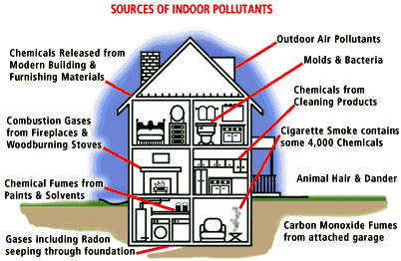
Sources of Air pollution
Indoor Air Pollution
use of fuels like coal, dung-cakes, wood, kerosene in their kitchens (incomplete
combustion produces carbon monoxide. Coal contains varying amounts of sulphur which on burning produces sulphur dioxide.
Fossil fuel burning produces black soot. These pollutants i.e. CO, SO2, soot and many others like formaldehyde, benzene α pyrene (BAP) are toxic and harmful for health)
Smoking (pyrene is also found in cigarette smoke)
using wood as fuel for cooking inhales BAP (equivalent to 20 packets of cigarette a day)
radioactive Radon (Ra222) causes indoor air pollution in concrete buildings.

Slide 14
Effects of Air pollution
1) Effects on human health -
A) Irritation on the respiratory tract.
B) Irritation of eye, nose and throat.
C) Pb particulate cause convulsions, coma and even death
D) HF causes fluorosis and mottling of teeth
E) A variety of pollens can initiate asthmatic attack
F) Hg results in kidney, nerve and brain damage
G) Ni causes respiration damage.
H)Cd particulates through cigarrette smoking cause cardiovascular diseases , kidney and liver damage and even death.

Slide 15
Effects of Air pollution
2) Effects on plants -
SO2 bleaches the leaf surface and causes chlorosis
NO2 causes premature leaf fall and necrosis.
O3 damage leaves
PAN is responsible for suppressed growth, silvering of lower leaf surface
Ethylene induces leaf abscission, leaf epinasty
CO causes curling and premature falling of leaves.

Slide 16
Effects of Air pollution
3) Effect on climate -
Increase of CO2
Global warming
Melting of ice, glaciers
Thinning of ozone layer
Penetration of UV rays

Slide 17
Effects of Air pollution
4) Effects on aquatic life –
Air pollutants mixing up with rain can cause high acidity (lower pH) in fresh water lakes. This affects aquatic life especially fish. Some of the freshwater lakes have experienced total fish death.
5) Effect on materials –
Because of their corrosiveness, particulates can cause damage to exposed surfaces. Presence of SO2 and moisture can accelerate corrosion of metallic surfaces. SO2 can affect fabric, leather, paint, paper, marble and limestone. Ozone in the atmosphere can cause cracking of rubber. Oxides of nitrogen can also cause fading of acetate, cotton and rayon fibres.

Slide 18
Control Measures of Air pollution
Air pollution can be minimized by the following methods:
· Siting of industries after proper Environmental Impact Assessment studies
· Using low sulphur coal in industries
· Removing sulphur from coal (by washing or with the help of bacteria)
· Removing NOx during the combustion process
· Removing particulate from stack exhaust gases by employing electrostatic
precipitators, bag-house filters, cyclone separators, scrubbers etc.
· Vehicular pollution can be checked by regular tune-up of engines,
replacement of old, more polluting vehicles, installing catalytic converters,
by engine modification to have fuel efficient (lean mixtures) to reduce CO
and hydrocarbon emissions and burning fuels slow and cooler to reduce
NOx emission (Honda Technology)
· Using mass transport system, bicycles etc.
· Shifting to less polluting fuels (hydrogen gas)
· Using non-conventional sources of energy
· By using biological filters and bio-scrubbers
· By planting more trees

Slide 19
