Slide 1
Controlling-Module 5

Slide 2
What is Controlling?
According to Brech, “Controlling is a systematic exercise which is called as a process of checking actual performance against the standards or plans with a view to ensure adequate progress and also recording such experience as is gained as a contribution to possible future needs.”
According to Donnell, “Just as a navigator continually takes reading to ensure whether he is relative to a planned action, so should a business manager continually take reading to assure himself that his enterprise is on right course.”
Controlling consists of verifying whether everything occurs in conformities with the plans adopted, instructions issued and principles established.
Controlling ensures that there is effective and efficient utilization of organizational resources so as to achieve the planned goals.
Controlling measures the deviation of actual performance from the standard performance, discovers the causes of such deviations and helps in taking corrective actions

Slide 3
Controlling has got two basic purposes:
It facilitates co-ordination
It helps in planning
Features of Controlling Function:
Following are the characteristics of controlling function of management-
Controlling is an end function- A function which comes once the performances are made in conformities with plans.
Controlling is a pervasive function- which means it is performed by managers at all levels and in all type of concerns.
Controlling is forward looking- because effective control is not possible without past being controlled. Controlling always looks to future so that follow-up can be made whenever required.
Controlling is a dynamic process- since controlling requires taking reviewal methods; changes have to be made wherever possible.
Controlling is related with planning- Planning and Controlling are two inseparable functions of management. Without planning, controlling is a meaningless exercise and without controlling, planning is useless. Planning presupposes controlling and controlling succeeds planning.

Slide 4
Process of Controlling:
Controlling as a management function involves following steps:
Establishment of standards- Standards are the plans or the targets which have to be achieved in the course of business function. They can also be called as the criterions for judging the performance. Standards generally are classified into two-
Measurable or tangible - Those standards which can be measured and expressed are called as measurable standards. They can be in form of cost, output, expenditure, time, profit, etc.
Non-measurable or intangible- There are standards which cannot be measured monetarily. For example- performance of a manager, deviation of workers, their attitudes towards a concern. These are called as intangible standards.
Controlling becomes easy through establishment of these standards because controlling is exercised on the basis of these standards.

Slide 5
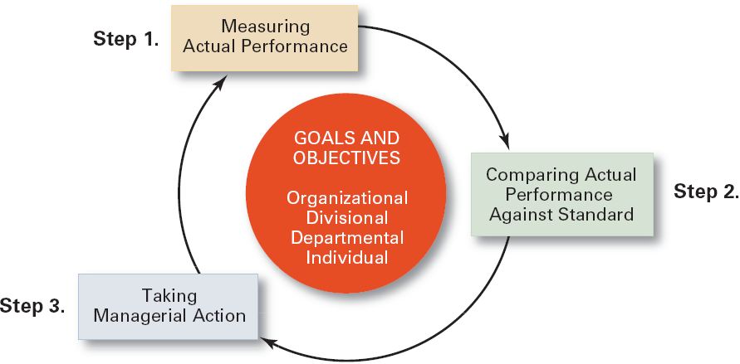
The Control Process

Slide 6
2. Measurement of performance- The second major step in controlling is to measure the performance. Finding out deviations becomes easy through measuring the actual performance.
Performance levels are sometimes easy to measure and sometimes difficult. Measurement of tangible standards is easy as it can be expressed in units, cost, money terms, etc.
Qualitative measurement becomes difficult when performance of manager has to be measured. Performance of a manager cannot be measured in quantities. It can be measured only by-
Attitude of the workers,
Their morale to work,
The development in the attitudes regarding the physical environment, and
Their communication with the superiors.
It is also sometimes done through various reports like weekly, monthly, quarterly, yearly reports.

Slide 7
3. Comparison of actual and standard performance- Comparison of actual performance with the planned targets is very important.
Deviation can be defined as the gap between actual performance and the planned targets.
The manager has to find out two things here- extent of deviation and cause of deviation. Extent of deviation means that the manager has to find out whether the deviation is positive or negative or whether the actual performance is in conformity with the planned performance.
The managers have to exercise control by exception. He has to find out those deviations which are critical and important for business. Minor deviations have to be ignored.
Major deviations like replacement of machinery, appointment of workers, quality of raw material, rate of profits, etc. should be looked upon consciously. Therefore it is said, “If a manager controls everything, he ends up controlling nothing.”
If stationery charges increase by a minor 5 to 10%, it can be called as a minor deviation.

Slide 8
Once the deviation is identified, a manager has to think about various causes which have led to deviation. The causes can be-
Erroneous planning,
Co-ordination loosens,
Implementation of plans is defective, and
Supervision and communication is ineffective, etc.
4. Taking remedial actions- Once the causes and extent of deviations are known, the manager has to detect those errors and take remedial measures for it. There are two alternatives here-
Taking corrective measures for deviations which have occurred and
After taking the corrective measures, if the actual performance is not in conformity with plans, the manager can revise the targets.
It is here the controlling process comes to an end. Follow up is an important step because it is only through taking corrective measures, a manager can exercise controlling.

Slide 9
Relationship between Planning and Controlling
Planning and controlling are two separate functions of management, yet they are closely related. Without the basis of planning, controlling activities becomes baseless and without controlling, planning becomes a meaningless exercise.
In absence of controlling, no purpose can be served by. Therefore, planning and controlling reinforce each other.
According to Billy Goetz, " Relationship between the two can be summarized in the following points:
Planning precedes controlling and controlling succeeds planning.
Planning and controlling are inseparable functions of management.
Activities are put on rails by planning and they are kept at right place through controlling.
The process of planning and controlling works on Systems Approach which is as follows:
Planning → Results → Corrective Action

Slide 10
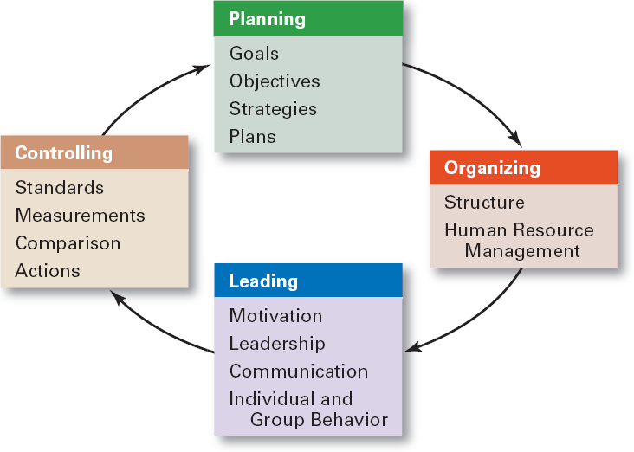
The Planning–Controlling Link

Slide 11
Planning and controlling are integral parts of an organization as both are important for smooth running of an enterprise.
Planning and controlling reinforce each other. Each drives the other function of management.
In the present dynamic environment which affects the organization, the strong relationship between the two is very critical and important.
In the present day environment, it is quite likely that planning fails due to some unforeseen events.
Therefore, controlling comes to the rescue. Once controlling is done effectively, it gives us stimulus to make better plans.
Therefore, planning and controlling are inseparable functions of a business enterprise.

Slide 12
Types of Controls

Slide 13
On the basis of time of their operation:
i. Predictive/Feed-forward Controls (Pre-Control)-ideally, controls should anticipate problems before they actually occur. They are called predictive controls e.g. survey of buying expectations of customer for the coming years.
ii. Concurrent Controls-these controls enable to take timely action before larger damage takes place. For instance, quality control charts used in production departments enables us to take immediate corrective action before additional products are produced.
iii. Historic /Feedback Controls(Post –Control)- they measure result after the happening of the events. They tell management to what extent objectives are actually accomplished. Financial and budgetary controls belong to this class of controls. Financial resource can measure efficiency of the firm in many areas.

Slide 14
Techniques of Control
Traditional or Conventional Techniques- such as Budgetary Control, Statistical Data and Reports, Break even analysis and Standard Costing.
Modern or Contemporary Techniques- such as Management Audit, PERT, CPM and Management Information System

Slide 15
The Budget as Control Technique

Slide 16
Budgetary Control
Budgetary Control involves the use of budgets to plan, coordinate and control day-to-day operations of business in accordance with the overall objectives of business.
A budget is a recorded plan of action expressed in quantitative terms. A budget is prepared to act as a means of controlling operations.
A budget has following characteristics:
it is prepared in advance and is based on a future plan of actions.
It relates to a future period and is based on objectives to be attained.
It is statement expressed in monetary and or physical units prepared for implementation of policy framed by the top management.

Slide 17
Budgetary control involves following three steps:
a) Preparation of budgets
Continuous comparison of actual results with planned ones.
Revision of plans or budgets in the light of changed circumstances.
Budgetary control is a useful technique of management control which brings efficiency and economy in the working of the business.
It facilitates control by establishing budgets in respect of each function and assigning responsibilities for control of actual performance and, thus, prevents buck passing when the budget figures are not met.
It coordinates the working of various divisions of a business and makes delegation and decentralization of authority possible.

Slide 18
Objectives of Budgetary Control
Determination of Goals- budgets are sub-plans for a specific period. They serve as goals for certain individuals. They are specific action programmes which are amenable to implementation through the various activity centres of the enterprise.
Rationalization of Activities- budgetary control is intended to impart precision, discipline, direction and predictability to the day-to-day activities of the enterprise.
Coordination- Budgets aim at coordination and integration of enterprise functions and operations performed by various departments. They highlight the inter-dependent nature of enterprise functions and operations as also the need for consistency in operations.
Participation- budgetary control provides participation to the subordinates. The subordinates can make their suggestions and comments on the budgeted estimates. Thus, budget making provides an opportunity for achieving cooperation and commitment of organizational members to the achievement of common goals.

Slide 19
v. Efficiency in Operations- a budget lays down sufficient and satisfactory norms of performance over various activities. It ensures efficient utilization of various resources of the enterprise.
vi. Control of Activities- Budgetary control is an important instrument of managerial control in any enterprise. It helps in comparing the performance of various individuals and departments with the predetermined standards laid down in various budgets.
It reports the significant variations from the budgets to the top management. Since separate budgets are prepared for each department, this helps in keeping down the cost of operation of different departments.

Slide 20
Types Of Budgets
Sales Budget- it is most important individual budget. All other budgets depend upon it Sales Budgets are the statements of anticipated sales volume in physical as well as financial terms during a particular financial year.
Revenue & Expense Budget- it is a statement of anticipated revenues and expenditure over a period of time.
Selling and Distribution Cost Budget- it is prepared along with the sales budget. It breaks down the figures for selling costs and distribution costs in groups convenient for controlling such costs.
Production Budget- it consists of the targets of monthly, quarterly, bi-annual and annual production by number of units, volume, weight for each product of the company.

Slide 21
5. Production Cost Budget-
Direct Material Budget- budget of those material which actually goes into the saleable final product of the company.
Direct Labour Budget- in this production levels are translated into labour strength required and subsequently into the wages cost.
Production Overheads Budget – Include all the expenses other than direct material and labour required for the factory. It consists of fixed and variable overhead.
6. Purchase Budget- direct material budget and overhead budget give consumption of materials in the production process. To arrive at the materials to be purchased, the consumption figures will have to be adjusted for the stock of raw materials.
7. Administrative Cost Budget- It gives all the costs for the administrative departments. These include salary, office expenses, financial expenses etc, of administrative unit.

Slide 22
8. Cash Budget- it is prepared after all the cost budgets are ready. The objective is to see whether the company will have sufficient cash to meet the various obligations during the year.
9. Capital Expenditure Budget- Every company has to spend money on capital account for modernization of equipment, expansion of capacity or diversification of activities. This budget relates to such programmes of capital nature.
10. Balance sheet Budget- It represents the estimates of the company’s assets, liabilities and net worth at the end of the financial year. Since the results of all the other budgets are reflected in the balance sheet budgets, it may indicate the need of revision of one or more kind of budget so that balance sheet presents the desired picture of the company’s assets and liabilities.
11. Research and Development Budget- It includes the cost of research and development activities from both, the long and short range, point of view. The value of research and development programme must also be clearly projected.
12. Master Budget- it is the essence of all departmental budgets. Having budgeted for various activities of the company, the Master budget shows the expected over all effect. This budget is prepared in the form of projected profit and loss account for the company and the projected balance sheet at the end of the budget period. It is this budget which the top management tries to ‘match’ with the goals set earlier.

Slide 23
Benefits of Budgeting
Budgets provide mgt. an overall view of the activities of the enterprise. They serve as a valuable aid to management through planning, coordination and control. They provide standards against which the actual performance is measured and helps in taking corrective actions in time.
Budgets are based on the well-defined plans. In preparation of various budgets, knowledge, skills and experience of many managers are combined and the plans of the enterprise are reduced into concrete numerical terms. Budgets enable the various departmental heads to know what is expected of them.
Budgeting helps in eliminating unproductive activities and minimising waste, because preparation of budgets involves a very careful analysis of various phases of business.
Budgeting coordinates effectively the activities of different departments and develops a sound communication system through meetings and discussions on budgeting and efficient system of reporting.
Budgetary control assists the top management in measuring the efficiency of departments and individuals and taking corrective actions. Thus, budgeting is an important technique of control.

Slide 24
6. Budgetary control facilitates ‘control by exception’. It helps in focussing the time and effort of the managers upon areas which are most important for the survival of the organization.
Limitations of Budgetary Control
In some companies, budgetary control programmes are so detailed that they become cumbersome, meaningless and unduly expensive. There is a danger in over budgeting as it may bring rigidity in the enterprise, which may deprive the managers of the needed freedom in managing their departments.
Budgets are usually based on historical trends which may not repeat in future. They may also be influenced by what top management would like to happen. Naturally, top management is interested in larger profits, lower costs and greater market shares and may make budgets to achieve these aims which may not be possible in actual practice.
Another danger lies in allowing budgetary goals to supersede enterprise goals. In their effort to keep within budget limits, the managers may forget that budgets are only means to enterprise goals. Top management may also be reluctant to excuse deviations from the budget estimates even though the causes of deviations may be justified.
Sometimes, budgets may be used to hide inefficiencies. A department may be inefficient even though its expenses are within the budget limits.

Slide 25
Control of Overall Performance

Slide 26
The important techniques of control of overall performance of a business enterprise are discussed below:
Budget Summaries- A budget summary is a resume of all individual budgets of the organization. It reflects overall business plans and identifies limitations and deficiencies. It helps the top management in visualizing how the organization is functioning in the direction of its objectives.
Profit and Loss Control- This is the most widely used means of control of overall performance of n enterprise. The profit and loss statement shows all the revenue, expenses and income for a given period .
Return on Investment- ROI is regarded a useful technique of control to evaluate the relative as well as absolute success of a business enterprise. It determines the ratio of earnings of the enterprise to its investment. That is why, it is called return on capital employed.
Ratio Analysis- Ratio Analysis is the process of analysing the relationship between two sets of figures relating to two important aspects of the company (current assets and current liabilities). A ratio may be financial or non-financial.
Responsibility Accounting- Responsibility accounting means a system of accounting whereby the performance of various people is judged by assessing how far they have been able to achieve the predetermined targets set up for the sections, divisions or departments for which they are responsible.

Slide 27
A responsibility centre is simply an organizational unit headed by a responsible person.
The responsibility centres may be subdivided into three categories:
Cost or Expense Centre
Profit Centre
Investment Centre
6. Control through Inter Firm Comparison- In order to assess the performance of an enterprise in its sector or area, the management of big business and industrial enterprises have adopted the practice of effecting top planning and control through inter firm comparison. Comparison is made between similar business in that particular industry.
7. Enterprise Self Audit- The enterprise’s self audit appraises a company’s position to determine where it is , where it is heading under present programs, what its objectives should be and whether revised plans are needed to meet those objectives. If an enterprise does not change course to suit the changing social, technical and political environment, it loses markets, personnel and other requirements for continued existence.

Slide 28
Productivity
Productivity is an average measure of the efficiency of production.
Productivity is a ratio of production output to what is required to produce it (inputs of capital, labor, land, energy, materials, etc.).
The measure of productivity is defined as a total output per one unit of a total input

Slide 29
Management Information System

Slide 30
Management Information System (MIS) is a system designed to supply information required for effective management of an organization.
An organization is managed by taking various decisions at the various levels of its management hierarchy. Information is needed to take these decisions.
Therefore, designing of an effective information system is vital for the efficient working of an organization.
Objectives of MIS
To make the desired information available in the right form to the right person and at the right time.
To supply the required information at the reasonable cost.
To use the most efficient methods of processing data.
To provide necessary security and secrecy for important and confidential information.
To keep the information up-to-date.

Slide 31
Globalization
Globalization- is the process of international integration arising from the interchange of world views, products, ideas, and other aspects of culture.
Put in simple terms, globalization refers to processes that promote world-wide exchanges of national and cultural resources.
Advances in transportation and telecommunications
infrastructure, including the rise of the Internet, are major factors in globalization, generating further interdependence of economic, and cultural activities.

Slide 32
Dimensions of Globalization
Globalization is composed of five dimensions:
Economic globalization refers to the intensification and stretching of economic interrelations around the globe. It encompasses such things as the emergence of a new global economic order, the internationalization of trade and finance, the changing power of transnational corporations, and the enhanced role of international economic institutions.
Political globalization refers to the intensification and expansion of political interrelations around the globe. Aspects of political globalization include the modern-nation state system and its changing place in today’s world, the role of global governance, and the direction of our global political systems.
Cultural globalization refers to the intensification and expansion of cultural flows across the globe. Culture is a very broad concept and has many facets. Topics under this heading include discussion about the development of a global culture, or lack thereof, the role of the media in shaping our identities and desires, and the globalization of languages.
Ecological globalization refers to the global environmental issues. Topics of ecological globalization include population growth, access to food, worldwide reduction in biodiversity, the gap between rich and poor as well as between the global North and global South, human-induced climate change, and global environmental degradation.

