Slide 1
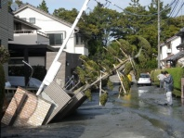
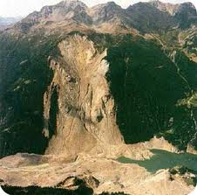
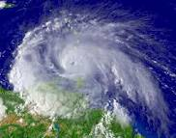
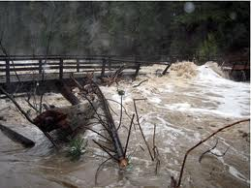
Disaster Management
A disaster is a natural or man-made hazard resulting in an event of substantial extent causing significant physical damage or destruction, loss of life, or drastic change to the environment. A disaster can be ostensively defined as any tragic event with great loss stemming from events such as earthquakes, floods, catastrophic accidents, landslides or cyclones.

Slide 2
Natural Disasters
A natural disaster is the effect of a natural hazard (e.g., flood, tornado, hurricane, volcanic eruption, earthquake, or landslide). It leads to financial, environmental or human losses. The resulting loss depends on the vulnerability of the affected population to resist the hazard, also called their resilience. This understanding is concentrated in the formulation: "disasters occur when hazards meet vulnerability.“ A natural hazard will hence never result in a natural disaster in areas without vulnerability, e.g. strong earthquakes in uninhabited areas.
Geological processes like earthquakes, volcanoes, floods and landslides are the normal events which have resulted in the formation of the earth that we have today. They are, however, feared as they result in severe consequences when they affect human population. Humans have witnessed many such natural hazards and have tried to learn to control these processes.

Slide 3
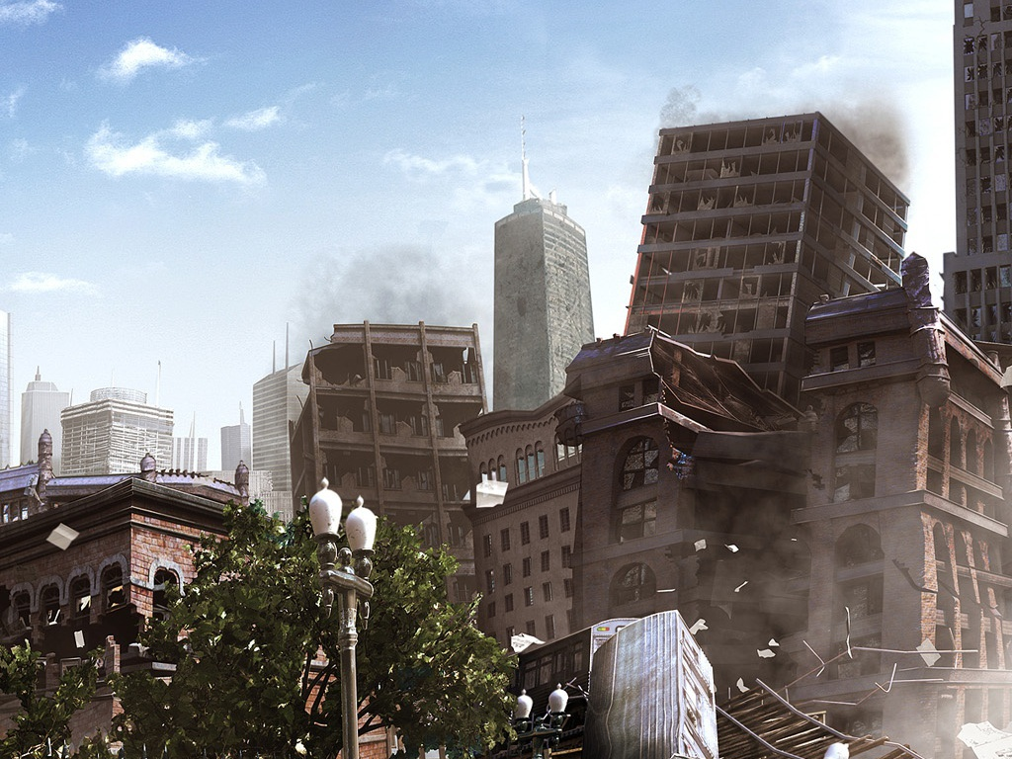
Earthquakes

Slide 4
Earthquakes
Earthquakes occur due to sudden movements of earth’s crust. The earth’s crust have several tectonic plates of solid rock which slowly move along their boundaries. When friction prevents these plates from slipping, stress builds up and results in sudden fractures which can occur along the boundaries of the plates or fault lines (planes of weakness) within the plates. This causes earthquakes, (the violent, short-term vibrations in the earth). The point on a fault at which the first movement occurs during an earthquake is called the epicenter. The severity of an earthquake is generally measured by its magnitude on Richter Scale.
Richter Scale Severity of earthquake
Less than 4 Insignificant
4 - 4.9 Minor
5 – 5.9 Damaging
6 - 6.9 Destructive
7 – 7.9 Major
More than 8 Great

Slide 5
Examples of Some Earthquakes
The largest earthquake ever recorded occurred on May 22,1960 in Chile with
the estimated magnitude of 9.5 on Richter Scale, affecting 90,000 square
miles and killing 6,000 people.
Earthquakes that hit various parts of our country with the magnitude on
Richter Scale are given below.
The devastating earthquake which hit Bhuj Town in Gujarat had cause
devastation killing 20,000-30,000 people and left many injured. It had an
energy equivalent to a 5.3 megaton hydrogen bomb.
Earthquake-generated water waves (may also be generated by volcanic
eruptions) called tsunamis can severely affect coastal areas. These giant
sea swells can move at a speed upto 1000 km/hr or faster. When
approaching sea shore may often reach 15m or more (upto 65 m) and cause
devastation in coastal areas. In China it killed 8,30,000 people in 1556 and
50,000 in 1976.

Slide 6
Seismic Activities and Control Measures
Human activities called seismic activities can also cause or increase
earthquake activities. These activities may cause minor earthquakes. Three
such identified activities include.
a) Added load of water in lake behind dam.
b) Under ground nuclear testing.
c) Deep well disposal of liquid waste.
Control Measures
Damage to property and causalities can be prevented by constructing
building in the earthquake prone zones which can withstand tremors. The
structures can be heavily reinforced. Strategically placing weak spots in the
building that can absorb vibrations from the rest of the building. To have
pads or floats beneath the building on which it can shift harmlessly with
ground motion. Wooden houses are preferred in earthquake prone areas.

Slide 7
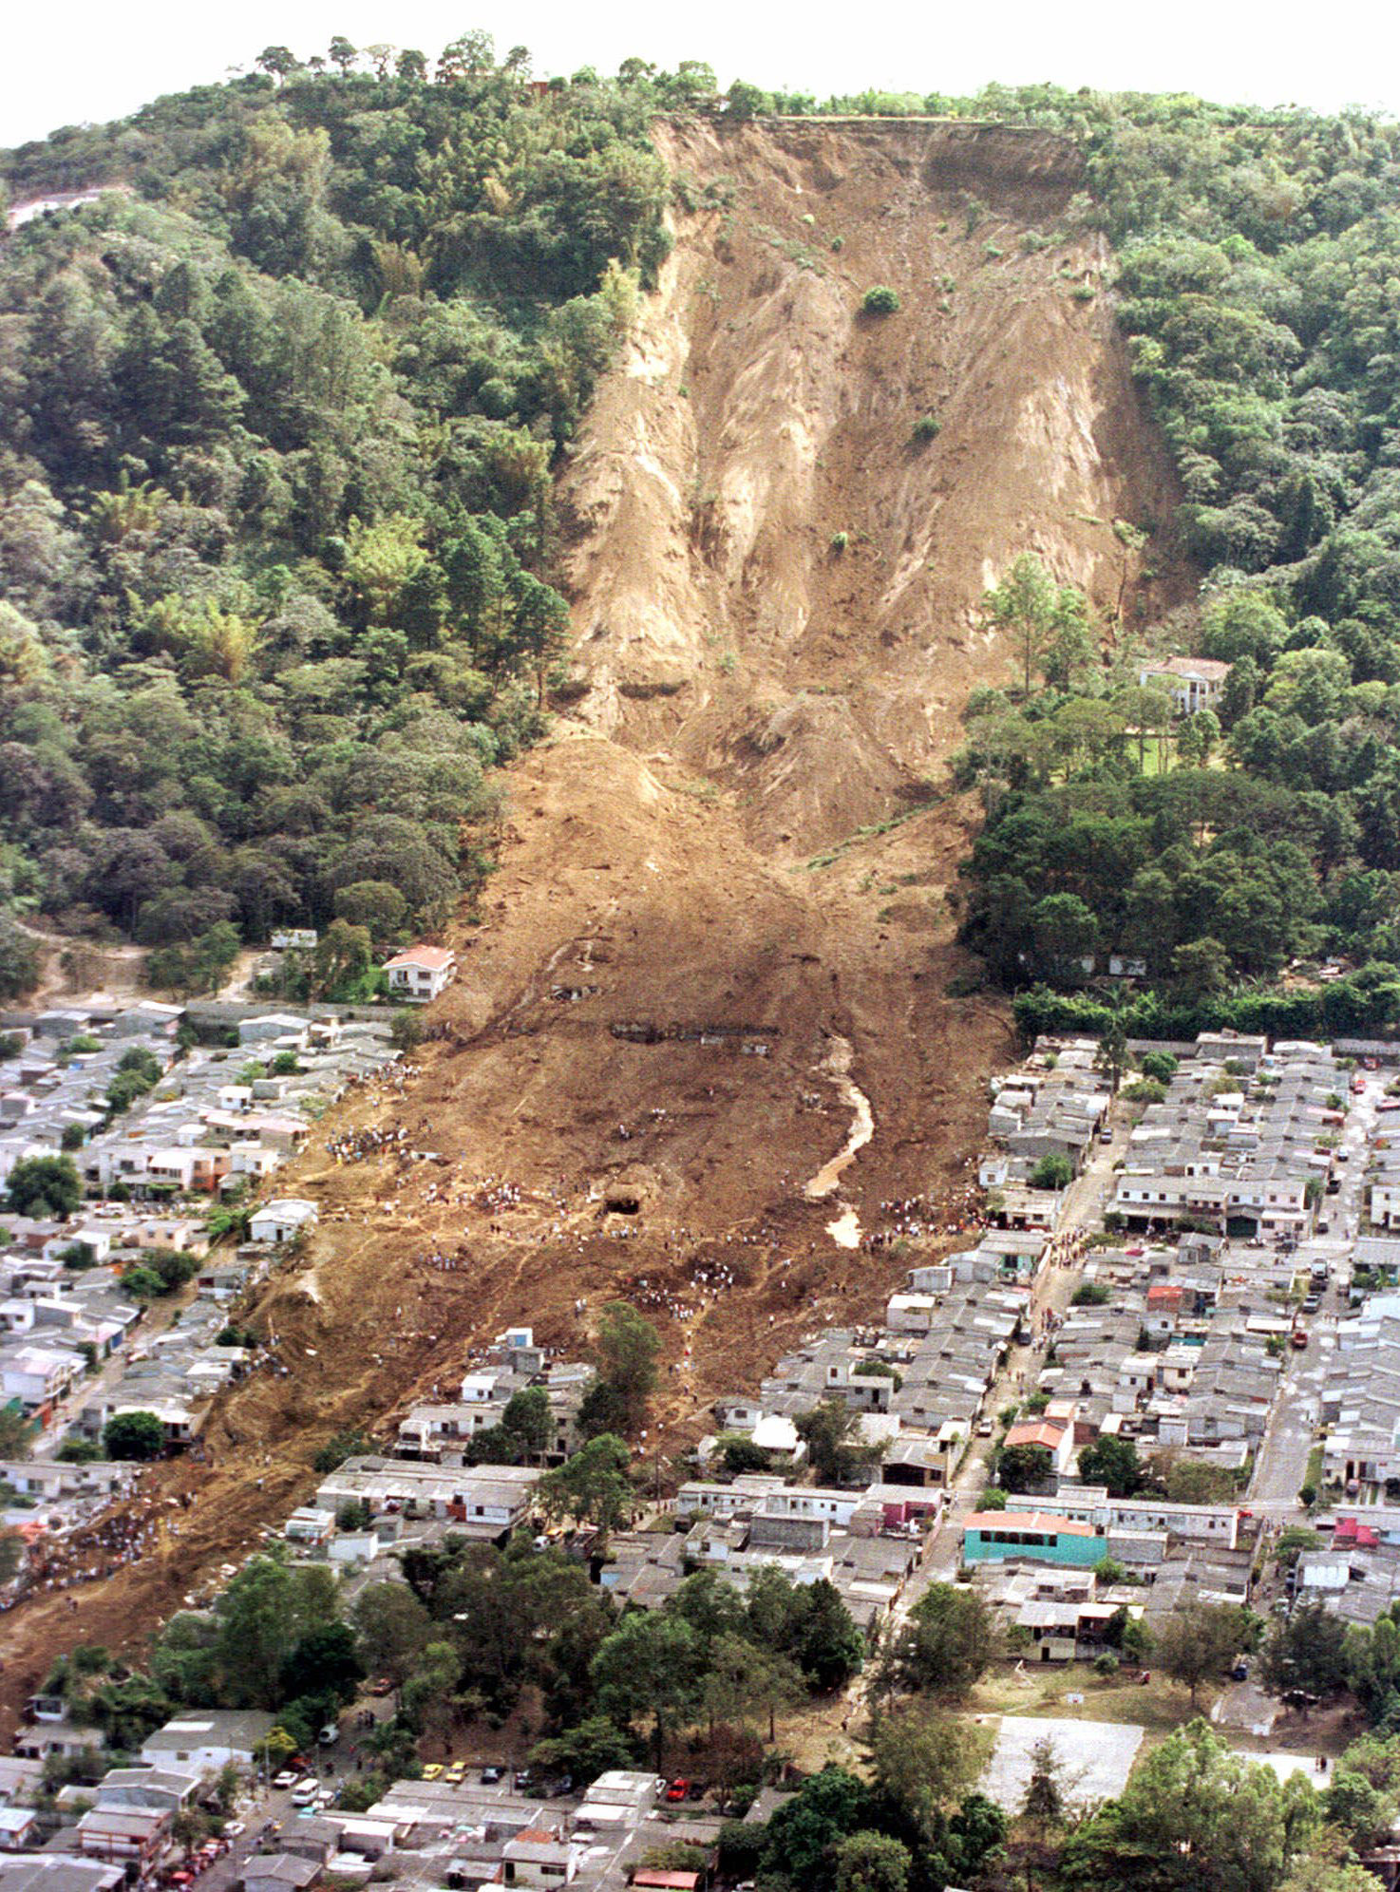
Landslides

Slide 8
Landslides
Landslide occurs when coherent rock of soil masses move down slope due
to gravitation pull. Slow landslips don’t cause much worry but sudden
rockslides and mudslides are dangerous. Water and vegetation influence
landslides. Chemical action of water gradually cause chemical weathering
of rock making it prone to landslides. Vegetation consolidates the slope
material, provides cohesion by its root system also retards the flow of water
and its erosion capacity.

Slide 9
Factors Influencing Landslides
this can be masked by many other exerting factors like:
i) Earthquakes, vibration etc.
ii) Disturbances in resistant rock overlying rock of low resistance.
iii) Saturation with water of the unconsolidated sediments.
iv) Unconsolidated sediments exposed by logging road or house building.
Landslides are governed by the forces which tend to pull earth material
down slope (move in case of slopes with steeper slip plane) and
resisting forces which tend to resist such movements.

Slide 10
Control Measures to Prevent Landslides
It is difficult to control landslides. However these can be minimized by
stabilizing the slope by:
i) Draining the surface & subsurface water.
ii) Providing slope support like gabions (wired stone blocks)
iii) Concrete – support at the base of a slope.

Slide 11
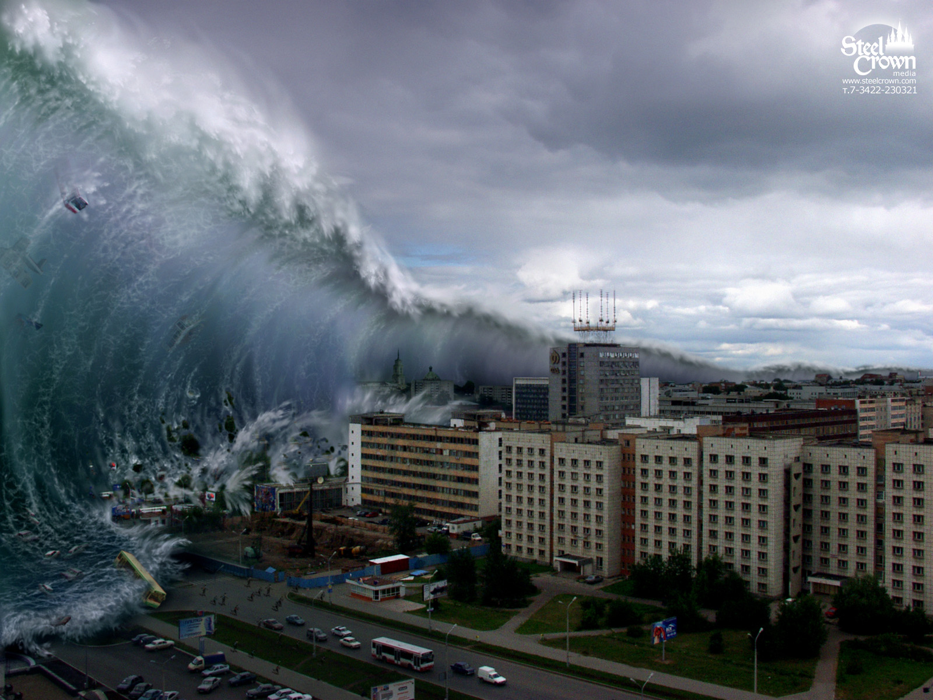
Tsunami !!!

Slide 12
Cyclones
Cyclones are recurring phenomena in the tropical coastal regions.
Tropical cyclones in the warm oceans are formed because of heat and
moisture. One of the requirements for formation of tropical cyclones is
that the sea surface temperature (SST) should be above 26°C. Tropical
cyclones move like a spinning top at the speed of 10-30 km per hour.
They can last for a week or so and have a diameter varying between
100 to 1500 km. Since in the western parts of the main ocean no cold
currents exist, tropical cyclones originate there. Tropical cyclones are
called hurricanes in the Atlantic, Caribbean and north eastern
Pacific, typhoons' is the western Pacific; 'cyclones' in the Indian
Ocean and 'willy willies' in the sea around Australia.

Slide 13
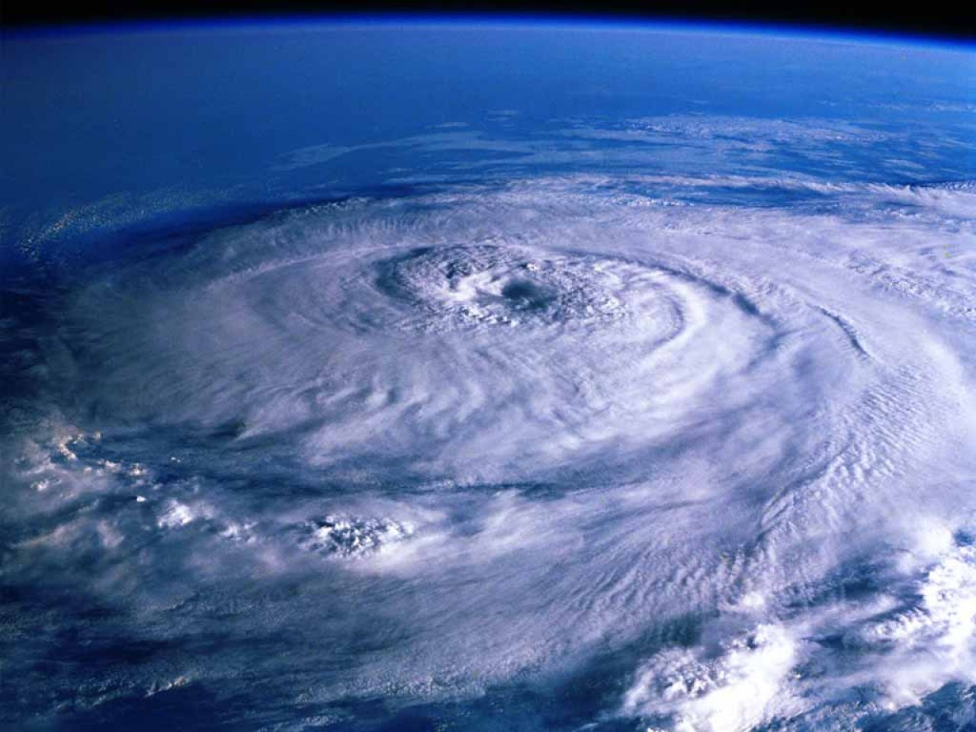
More storms form in the Bay of Bengal than in the Arabian Sea. Of 5-6
storms that forms in the year about half of them are severe. Hurricane
winds (74 miles per hour or more) rains and storm surge (often 50-100
miles wide dome of water) often devastate the area where it strikes on
land. The devastation is more when storm surge and normal astronomical
tide coincide. Sea water with combined force rushes inlands and
inundates the low lying areas.

Slide 14
Management of Cyclones
It is difficult to stop the recurrence of cyclones.
Some long term defence measures can help to protect us from
devastation. Such measures include, planting more trees on the
coastal belt, construction of dams, dykes, embankments, storm
shelter, wind breaks, proper drainage, wide roads for quick evacuation.

Slide 15
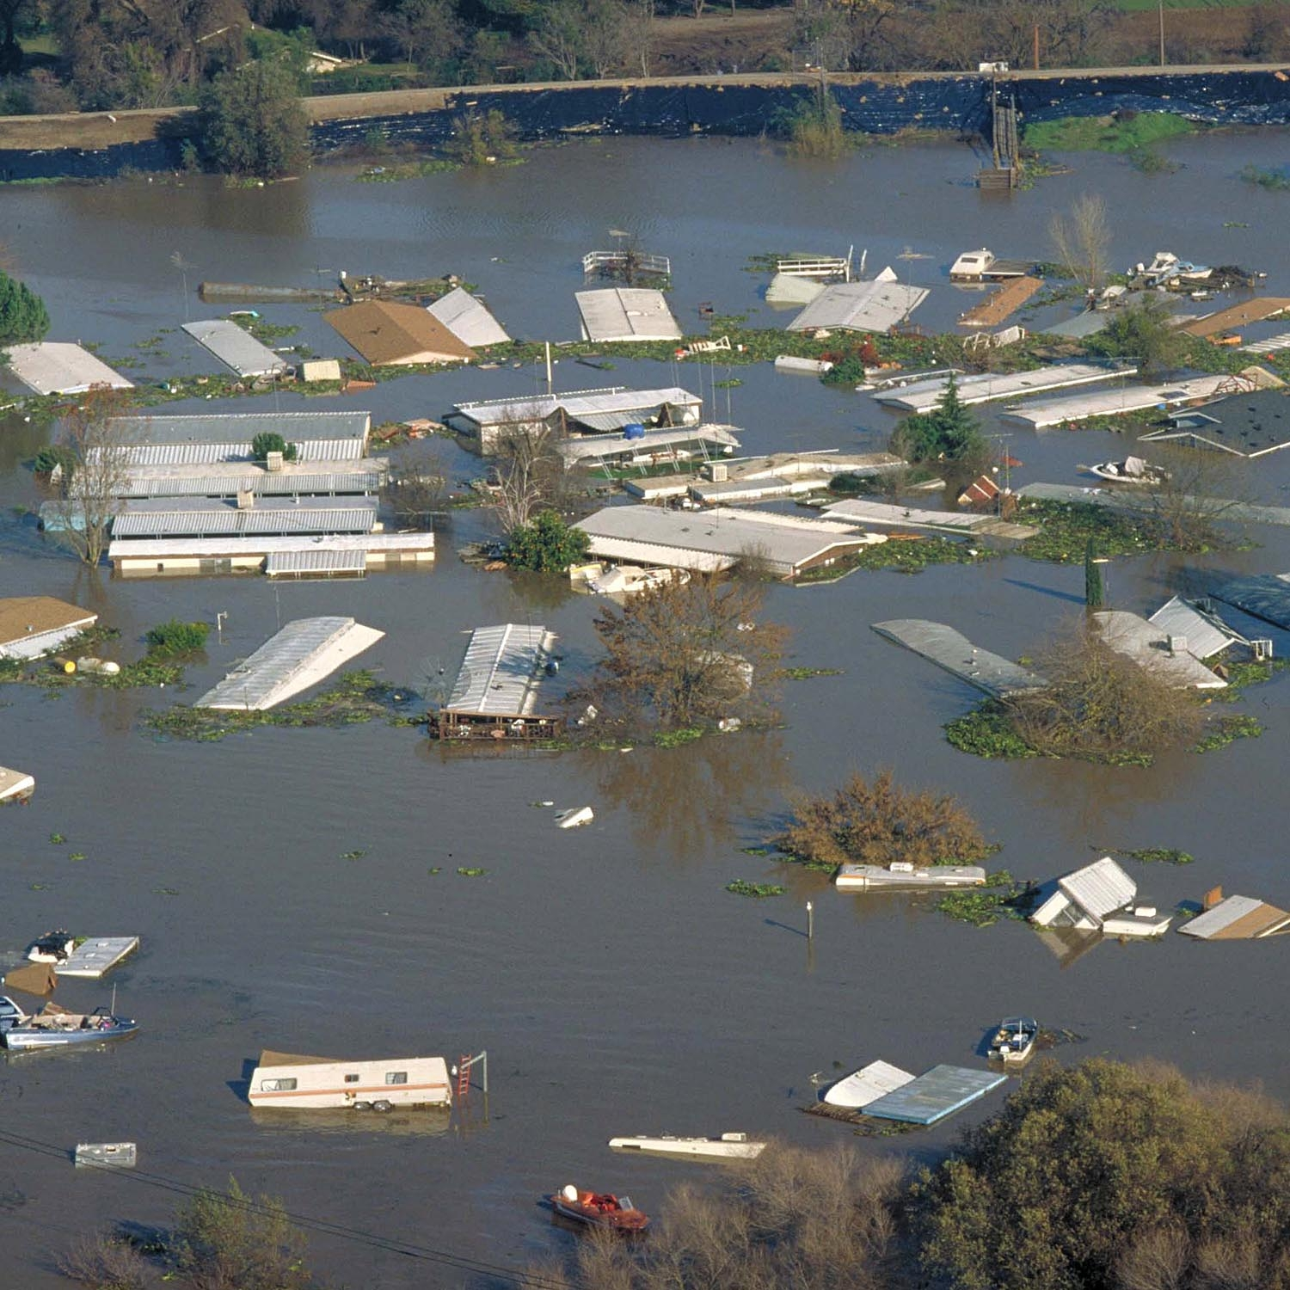
Flood!

Slide 16
Floods
Generally, the stream channels accommodate average maximum stream
flow. However, due to heavy rains or sudden snow melt the quantity of water
in streams exceeds their capacity and water overflows the banks and
causes inundation of the surrounding land. This situation is called flood.
A flood generally doesn’t damage property or cause causalities as compared
to other natural disasters. However, it causes a great economic loss as it
causes widespread contamination.
Flood plains, the low lying areas which get inundated during floods help to
reduce floods. With the building up of the flood control structures like
building of flood walls, deepening of river channels just transfers the
problems downstream. Building walls prevents spilling out the flood water
over flood plains. Rather it increases the velocity of water to affect the areas
downstream with force.

Slide 17
Control Measures
To check floods, many people are of the opinion that money should be
spent to restore wetlands, replace ground cover on water-courses,
build check-dams on small streams, move buildings off the flood plains
etc. Instead of raising buildings on flood plains, it is suggested that
floodplains should be used for wildlife habitat, parks, recreational areas
and other uses, which are not susceptible to flood damage.

Slide 19
Role of individual in prevention of pollution
“Think globally act locally”.
It can be done by following some of the following suggestions.
Help in pollution prevention more than pollution control.
Use ecofriendly products.
Cut down the use of chlorofluorocarbons (CFC) as these destroy ozone layer. Do not use polystyrene cups that have chlorofluorocarbon (CFC) molecules in them which destroy ozone layer.
Use the chemicals derived from peaches and plums to clean computer chips and circuit boards instead of CFCs.
Use CFC free refrigerators.
The manufacture and operation of such devices that don’t pollute should
be encouraged. If they cost more then their higher prices may be offset by
including environmental, the social costs of pollution in the price of such
products which pollute environment.
Air pollution can be prevented by using really clean fuel i.e. hydrogen fuel.
Hydrogen for that matter should not be produced by passing current in
water as for generation of this current, again the environment will be
polluted. So solar powered hydrogen fuel is the need of the hour.

Slide 20
Ways to Prevent Pollution
Reduction in the dependency on fossil fuel especially coal or oil.
Save electricity by not wasting it when not required because electricity saved is electricity generated without polluting environment.
Put on warm cloths than switching on a heater.
Adopt and popularize renewable energy sources.
Improve energy efficiency. This will reduce the amount of waste energy, i.e. more is achieved with less energy.
Increase reuse, recycling, and reduce the production of wastes.
Use mass transport system. For short-visits use bicycle or go on foot. Decrease the use of automobiles.
Use pesticides when only absolutely necessary and that too in right amounts. Wherever possible alternate pest control methods (biological control) should be used.
Use rechargeable batteries. Rechargeable batteries will reduce metal pollution.

Slide 21
Use less hazardous chemicals wherever possible. Baking soda, vinegar and borax can help in cleaning and cloth bleaching and softening. Baking soda can replace modern deodorants.
The solid waste generated during one manufacturing process can be used as a raw material for some other processes.
Use low phosphate or phosphate-free or biodegradable dish washing liquid, laundry detergent and shampoo. This will reduce eutrophication of water bodies.
Use organic manure instead of commercial inorganic fertilizers.
Do not put pesticides, paints, solvents, oils or other harmful chemicals into the drain or ground water.
Use only the minimum required amount of water for various activities. This will prevent fresh water from pollution.
When building a home, save (don’t cut) as many as possible trees in the area.
Plant more trees.
Check population growth.

